Slide 1
Finding a Better Place in Scarborough, Toronto
ALLPPT.com _ Free PowerPoint Templates, Diagrams and Charts

Slide 2
Introduction :
This Capstone Project aim to create an analysis of features for a people migrating to Scarborough to search a best neighborhood as a comparative analysis between neighborhoods
The features include median housing price and better school according to ratings, crime rates of that area, road connectivity, weather conditions, good management for emergency, water resources both fresh and wastewater and excrement conveyed in sewers and recreational facilities.
It will help people to get awareness of the area and neighborhood before moving to a new city, state, country or place for their work or to start a new fresh life

Slide 3
Data Section
Data Link: https://en.wikipedia.org/wiki/List_of_postal_codes_of_Canada:_M
Foursquare API Data: We will need data about different venues in different neighborhoods of that specific borough.In order to gain that information we will use “Foursquare” locational information.
After finding the list of neighborhoods, we then connect to the Foursquare API to gather information about venues inside each and every neighborhood. For each neighborhood, we have chosen the radius to be 100 meter.
The data retrieved from Foursquare contained information of venues within a specified distance of the longitude and latitude of the postcodes. The information obtained per venue as follows:.
Neighborhood
Neighborhood Latitude
Neighborhood Longitude
Venue
Name of the venue e.g. the name of a store or restaurant
Venue Latitude
Venue Longitude
Venue Category

Slide 4
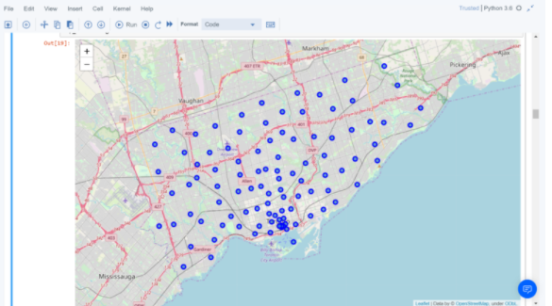
Map of Scarborough:

Slide 5
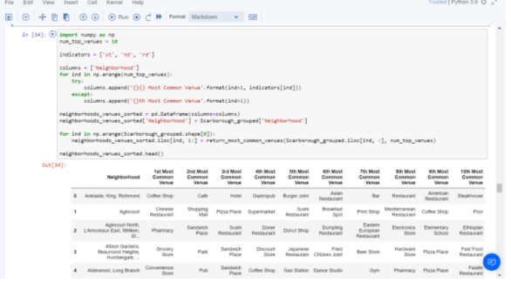
Methodology Section: Clustering Approach: To compare the similarities of two cities, we decided to explore neighborhoods, segment them, and group them into clusters to find similar neighborhoods in a big city like New York and Toronto. To be able to do that, we need to cluster data which is a form of unsupervised machine learning: k-means clustering algorithm.

Slide 6
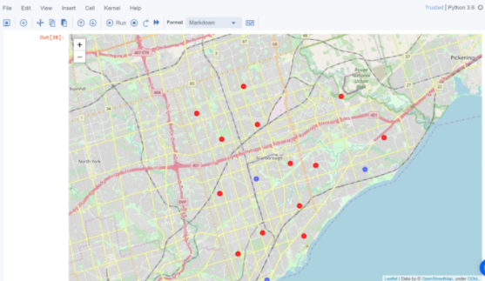
Map of Clusters in Scarborough

Slide 7
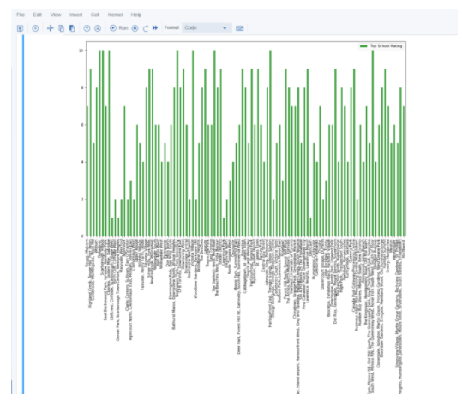
School Ratings by Clusters in Scarborough

Slide 8
The Location:
Scarborough is a popular destination for new immigrants in Canada to reside. As a result, it is one of the most diverse and multicultural areas in the Greater Toronto Area, being home to various religious groups and places of worship. Although immigration has become a hot topic over the past few years with more governments seeking more restrictions on immigrants and refugees, the general trend of immigration into Canada has been one of on the rise.
Foursquare API:
This Capstone project have used Four-square API as its prime data gathering source as it has a database of millions of places, especially their places API which provides the ability to perform location search, location sharing and details about a business.

Slide 9
Conclusion Section:
In this Capstone project, using k-means cluster algorithm I separated the neighborhood into 10(Ten) different clusters and for 103 different lattitude and logitude from dataset, which have very-similar neighborhoods around them
Using the charts above results presented to a particular neighborhood based on average house prices and school rating have been made.
This Capstone project can be continued for making it more precise in terms to find best house in Scarborough. Best means on the basis of all required things(daily needs or things we need to live a better life) around and also in terms of cost effective.

